Slide 1
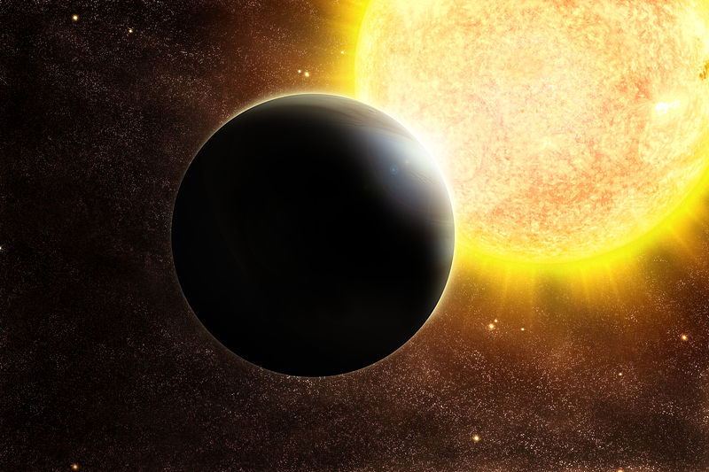
The Study of Exoplanetary Atmosphere with IGRINS
Keun-Hong Park
Seoul National University
Notes:
Good Afternoon, Everyone. My name is Keun-Hong Park, and I am a graduate student in Seoul National University.
Now, I am going to present my IGRINS project about the exoplanetary atmosphere.
This study is currently underway, so the result in this time does not mean the conclusion of this project.

Slide 2
Outline
Introduction
Method
Observation
Analysis
Result
Notes:
My presentation is as follow in this order. After introduction, I’ll talk about the method of this study. I’ll show the current state of my IGRINS observation, and I’ll brief the analysis and the result.

Slide 3
Introduction
Why Exoplanetary Atmosphere?
Formation of the Planetary System
Environment of Exoplanet
Extraterrestrial Life
Notes:
The exoplanets is one of the most hottest field in the modern astronomy. Since the first exoplanet detection in 1995, about two thousand exoplanets are found in last two decades. We found the multiple exoplanet systems, some planets in habitable zone, and the planets from larger the Jupiter to smaller than the Mercury. It means, we already found almost thinkable type of the exoplanets. So, the today’s exoplanetary science is going to further more than the detection.
Therefore I choose the atmosphere. Why do I choose the exoplanetary atmosphere? First, it can be helpful for the understanding for the formation and the evolution of the planetary system.
And, the extraterrestrial life is the hottest issues in not only astronomer but also the public. To determine the possibility for the extraterrestrial, to know the environment of exoplanet is very important, and the properties of atmosphere like as composition is an important clue for that.

Slide 4
IGRINS
Instruments of the previous studies
NICMOS (HST)
CRIRES (VLT)
OSIRIS (KECK)
…
IGRINS (McDonald)
H & K band (1.49-2.46 ㎛) at once : Wide wavelength coverage
R ~ 40,000 : High Resolution
The Goal of this study
Finding of new molecular features
The properties of exoplanetary atmospheres
Notes:
After the first detection in 2002, there are the several studies of the exoplanetary atmosphere. Almost observation were done in infrared region. The used instruments of those studies are NICMOS in Hubble Space Telescope, CRIRES in VLT, OSIRIS in KECK and so on. But these instruments have too low resolution like NICMOS , so it is difficult to do the detail study, or have too narrow wavelength coverage like CRIRES so it is good for the study using the known molecular, but not suitable for finding the new molecular in the atmosphere.
IGRINS has both wide wavelength coverage and high resolution, so it is suitable instrument for both finding the new molecular lines and doing further study at once.
From the observation data, I am going to try to find the new molecular in the exoplanetary atmosphere which is never detected yet, and also try to study the properties of exoplanetary atmosphere.

Slide 5
Method
Absorption line in Primary Eclipse
Thermal emission in Secondary Eclipse
Notes:
There are two methods to detect the exoplanetary atmosphere in the transit planets. The first one is using the absorption lines in the primary eclipse, and the second one is using the thermal emission in the secondary eclipse. I’ll use the first one method.

Slide 6
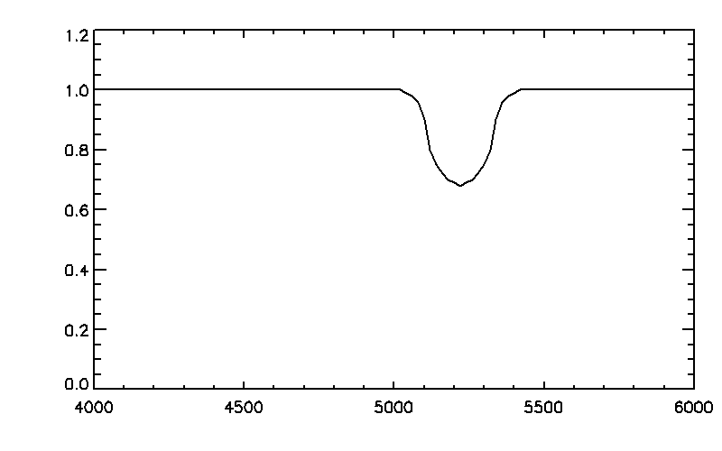
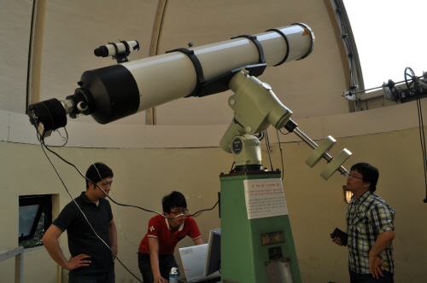
Method
Notes:
The yellow circle is the host star, the green circle is the exoplanet and here is the observatory. In this state, we can get the full flux from the host star.

Slide 7
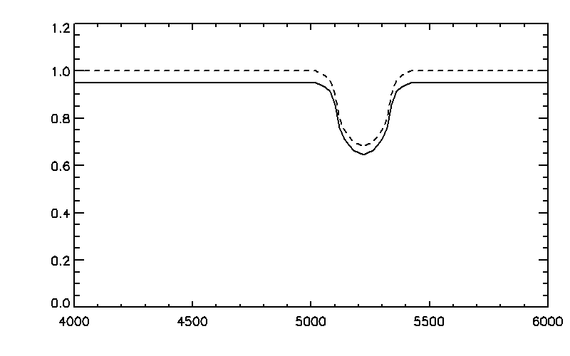
Method
Notes:
The transit is occurred, then the flux is little decreased by the blocking of the planet.

Slide 8
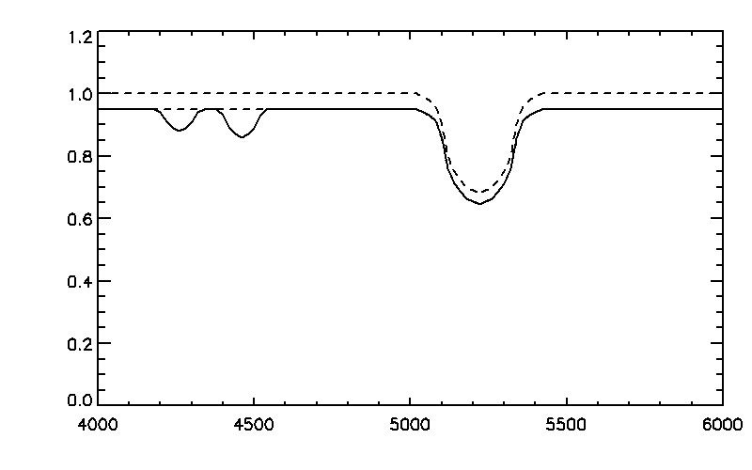
Method
Notes:
If the planet has the atmosphere, the flux where the molecular lines are located is little bit more decreased than others.
We can find this absorption features from the comparing the reduction ratio between the lines and continuums.

Slide 9
Observation
Month/Year | Nights | Observation Result
2014 T3 09/2014 | 3 | Cloudy
2015 T1 03/2015 | 2 | Cloudy
2015 T2 04 – 05 / 2015 | 3 | Apr. 29 – Tau Boo May. 1 – WASP3
Notes:
Thankfully, I got eight nights in three trimester for this study. However, I could observe only two nights because the bad weather.
The observed targets are Tau Boo and WASP 3.

Slide 10
Observation
Tau Boo b
Non-Transit Star
F6IV
H ~ 3.6
Rplanet/Rstar = 0.08
Observed on Apr. 29
Clear
In Transit (?) : 120sec × 64 , S/N ~ 1200 at 1.6
Out of Transit (?) : 120sec × 64 , S/N ~ 1100 at 1.6
WASP-3 b
F7V
H ~ 9.4
Rplanet/Rstar = 0.11
Observed on May 1
Clear -> Cloudy
In Transit : 240sec × 14 , S/N ~ 120 at 1.6
Out of Transit : 240sec × 22 , S/N ~ 220 at 1.6
Notes:
From the recent study, Tau Boo is turned out the non-transit planet.
But in the data of the transit search program which I used, Tau Boo still remains transit star, and I couldn’t check it also. That’s my mistake. When I was at the observatory, I lost my reason.
“Wow, what a bright star this is! And the observable time is enough long! It’s perfect target!”, after observation, I was confounded to know that star is not transit star.
Anyway, Tau Boo is very bright star. The weather was clear and observable time is enough long, so we can reach the high signal to noise ratio. I wrote in-transit for convenience, actually it is the near the point where the orbital phase is 0.
WASP-3 is about 9.4 magnitude in H band. The weather was clear at first, however it became cloudy at the last moment. Therefore the signal to ratio of the in-transit-phase spectra is not good.

Slide 11
Analysis
Line
HITRAN 2012
Shift of the lines
Tau Boo : Radial Velocity from SIMBAD
WASP-3 : Calculation from Mg I line (1710.86 nm)
1.475 μm
Long Wavelength
1.816 μm
23 | 22 | 21 | 20 | 19 | 18 | 17 | 16 | 15 | 14 | 13 | 12 | 11 | 10 | 9 | 8 | 7 | 6 | 5 | 4 | 3 | 2 | 1
NH3
CO
CH4
OH
CO2
N2O
HCl
H2S
H2O
C2H2
C2H2
HI
Notes:
The line list in my study is from HITRAN 2012.
For Tau Boo, I adopted the radial velocity from the SIMBAD, so I could derive the shift of lines.
However WASP-3 doesn’t have the radial velocity in SIMBAD, so I estimate the shift from the Mg I line at 1710 nm.
In H band, we could try in the 11 molecular as like, ammonia, carbon monoxide, methane, hydroxyl, CO2, nitrous oxide, hydrogen chloride, hydrogen sulfide, water vapor, acetylene, and hydrogen iodide.

Slide 12
Analysis
Stellar - planet
Stellar – planet - atmosphere
$${(\frac{F_{in}}{F_{out}})}_{Continuum} > {(\frac{F_{in}}{F_{out}})}_{Line}$$
stellar
stellar
Notes:
As referred to earlier, the flux reduction ratio in continuum and those in lines are different. When the transit out, the flux is come from the host star intact.
When the transit occurred, the flux is decreased as like the size ratio of planet, and more decreased in the lines by absorption of the atmosphere.
So I am going to prove statistically that the left side is larger than the right side.

Slide 13
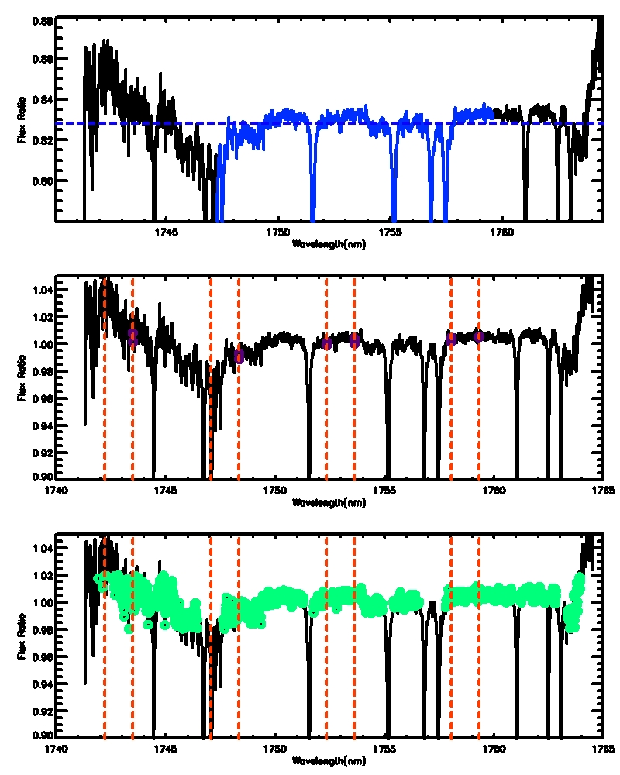
Analysis
< 0.01 nm from the molecular lines
Away from telluric & other contamination.
> 0.05 nm from the molecular lines
Away from telluric & other contamination.
Pixels of the lines
Pixels of the continuum
K-S Test
Probability that two groups are same
Low Probability : Differences between lines & Continuum
Notes:
I have to define the lines and the continuum.
These figures are the ratio between the transit-in and transit-out. By the dividing the spectrum, all elements which can affect the spectra as like stellar components, interstellar lines, blaze function are removed.
But as you can see, the telluric lines are not removed perfectly, especially in the strong lines. Also, I don’t know why but there are some patterns at the edge of spectra in almost order.
I normalized the spectra by the median value of the blue region. After that, I throw away the pixels which is far from the normalized value, so I used the green pixels in this order.
The red dashed lines are the hydrogen chloride lines in this order. Among the green pixels, the lines are the pixels within 0.01 nm from the molecular line, and the continuum is further than 0.05 nm.
To find the differences between two groups, I did the K-S test. It gives to me the probability that the two groups are statistically same.
So, if this probability is low, then there may be differences between two groups.
I did K-S test in 11 molecular lines, in two target. The best scenario to me, there are no differences in Tau Boo because it is non-transit star, and there are differences in WASP-3, the transit star.

Slide 14
Result
K-S test with 11 molecular in the spectra of two target stars.
Expected Result
Tau Boo (non-Transit) : All of the probabilities are high .
WASP-3 (Transit) : Some of the probabilities are low.
WASP-3
Couldn’t find any evidence of the atmosphere
Notes:
I did K-S test in 11 molecular lines, in two target. The best scenario to me, all of the probabilities are high in non-Transit star Tau Boo, it means there is no difference between lines and continuums. And there are differences in WASP-3, the transit star.
But unfortunately, my result is far from the best scenario. First, no evidence of the exoplanetary atmosphere is detected in WASP-3. Although I am sorry to say that I could not find the evidences of atmosphere, in fact, this result is not big problem. There might be no atmosphere at that planet, or simply, it’s the Signal to Noise ratio problem.

Slide 15
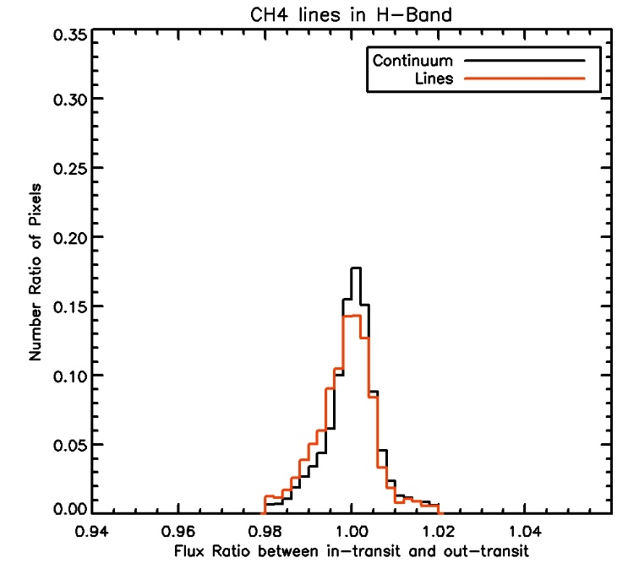
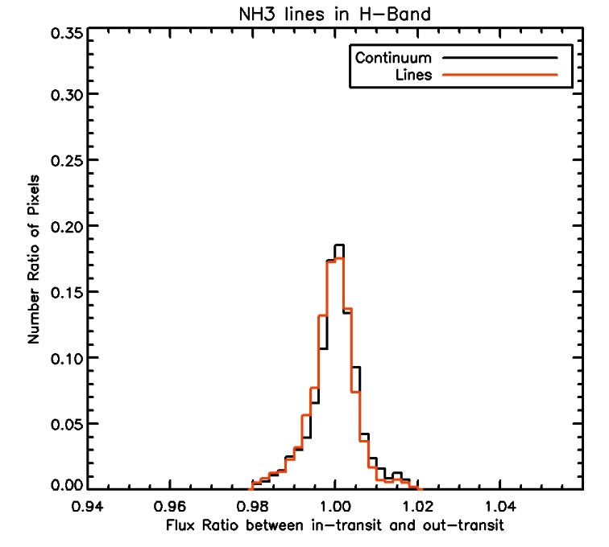
Result
Tau Boo
CH4, NH3, H2S shows the low probability.
????
$$p=2.5 ×{10}^{−15}\%$$
$$p=4.3 ×{10}^{−4}\%$$
$$p=2.1 ×{10}^{−3}\%$$
Notes:
The real problem is that, I don’t know why, but three molecular have low probabilities in the case of Tau Boo.
Especially, in case of Hydrogen sulfide, the flux ratio in the pixels of lines are larger than those of continuum. It means there is emission in exoplanetary atmosphere. It’s more impossible. So I think that there is some mistakes in my analysis. So, I will try to find the problems in my analysis and to improve it.

Slide 16
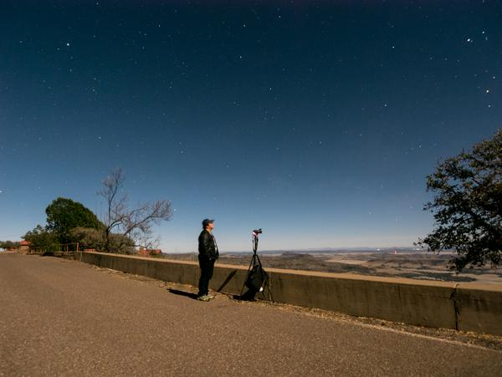
Thank You

