Slide 1
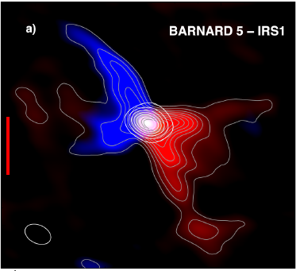
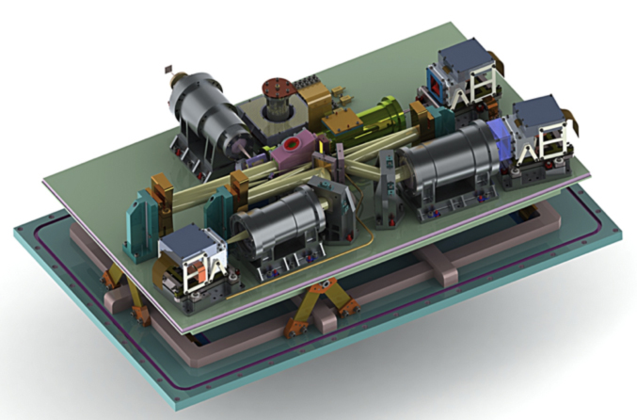
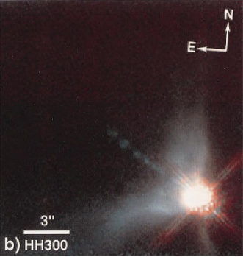
IGRINS spectroscopy of Class I sources, IRAS 03445+3242 & IRAS 04239+2436
12CO 2-1
IRAS 03445+3242
IGRINS
IRAS 04239+2436
NICMOS
[Fe II] 1.644 um
H₂ 2.122um
Seokho Lee¹, Jeong-Eun Lee¹, Sunkyung Park¹, Jae-Joon Lee²,
Benjamin Kidder³, Gregory Mace³, and Daniel T. Jaffe³,
¹KHU, ²KASI , ³Univ. of Texas,
Preliminary results of
IGRINS Survey of Protoplanetary Disks (Korean legacy program)

Slide 2
Contents
Introduction
Targets
Previous works
CO overtone emission
Observation & Data reduction
Model
Results & Discussions
Summary

Slide 3
Targets : Class I sources
 | IRAS03445+3242 | IRAS04239+2436
R.A. | 03:47:41.60 | 04:36:56.30
Dec. | +32:51:43.8 | +24:43:35.3
D (pc) | 280 | 140
L_{bol} (L_{ʘ}) | 3.8 | 1.1
Ks (mag) | 11.214 | 9.764
Av (mag) | 10 | 25
Other name | B5-IRS 5 HH 366 VLA 1 | HH 300 VLA 1
Low spectral resolution NIR spectroscopy
High veiling excess
Contamination of photospheric lines is small!!
Connelley & Greene (2010)

Slide 4
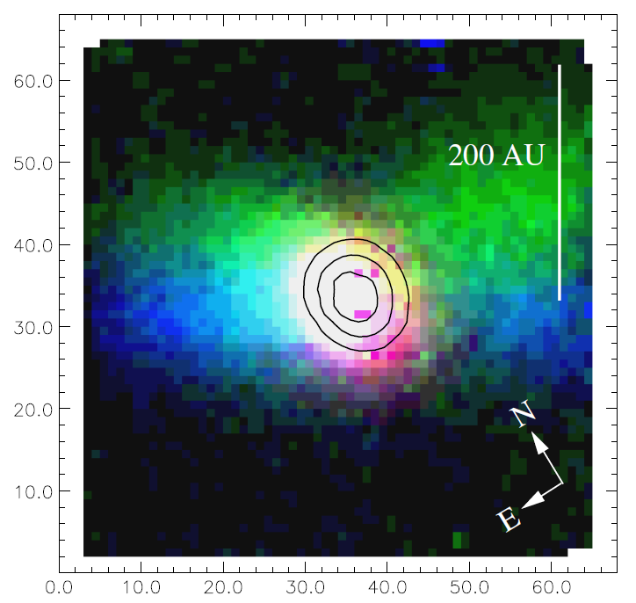
Previous works: VLT integral field spectroscopy
Davis et al. (2011)
R ~ 1500
Accretion tracer : Br γ
Jet & outflow : [Fe II] , H₂
Disk : CO overtone Na I, Ca I, Mg I
cont. 2.16 μm
Br γ 2.166 μm
H₂ S(0) 2.122 μm
[Fe II] 1.644 μm

Slide 5
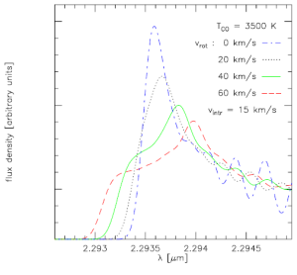
CO overtone (∆v=2) rovibrational emission
Emitted from hot (2500-5000 K) and dense (n > 10¹¹ cm⁻³) gas (Calvet et al. 1991, Martin 1997)
~0.15 AU of Keplerian disk in T Tauri & Herbig Ae/Be stars (e.g. Najita et al. 1996, 2009; Thi et al. 2005)
CO overtone band head profile
→ disk rotation
Rings of constant
rotational velocities
(Kraus et al. 2000)

Slide 6
Observation & Data Reduction
Observation
IRAS 03445+3242 on 20 Jan. 2015
IRAS 04239+2435 on 26 & 27 Nov. 2014 (twice)
Calibration with the IGRINS Pipeline (Jae-Joon Lee)
Telluric line correction with the observation of A0 stars.
the difference in airmass and changes in wavelength solution are also considered (0th order approximation).
HI recombination lines in A0 stars are corrected by using Vega spectrum (Gaussian-convolved with a fitted V_{rot})
Absolute flux calibration using 2MASS data.

Slide 7
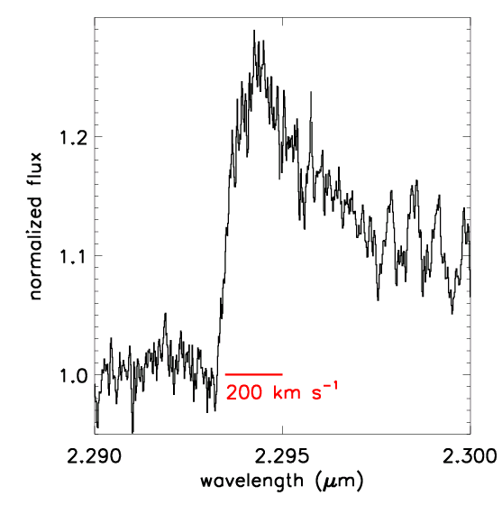
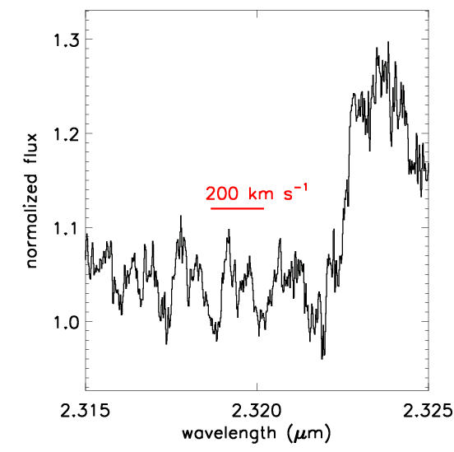
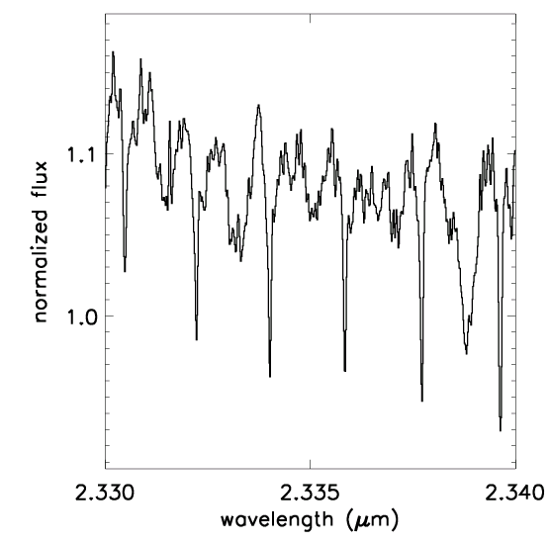
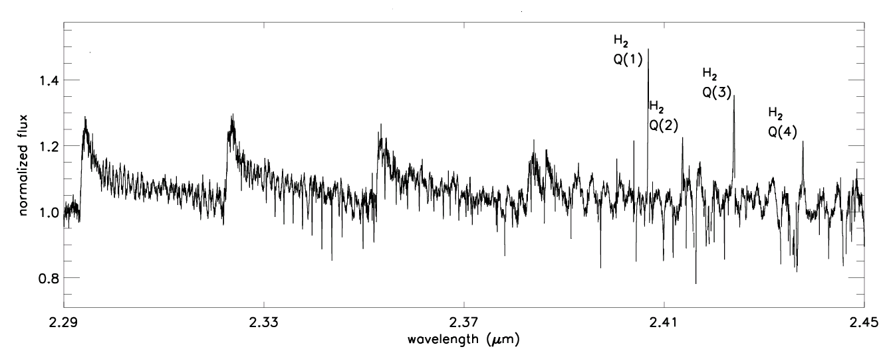
CO band of IRAS 03445+3242
Broad bandhead
Double peak s
in isolated lines
Narrow
absorption lines
v= 2-0
v= 3-1
v= 4-2
v= 5-3

Slide 8
Model : CO overtone emission
Modified from Najita et al. (1996)
8 parameters for disk model (4 free parameters )
V₀ (at inner radius) : V_{max} = V₀ r^{-0.5} (Keplerian rotation)
T₀ & p (=0.5) : T_{gas} = T₀ r ^{–p}
N₀ & q (=1.5) : N(CO) = N₀ r ^{–q}
β : the ratio of R_{out} / R_{in} : T_{gas}(R_{out})= 1000 K, (R_{in} = 1)
FWHM (line width)
V_{LSR} : radial velocity of source
For given T_{gas}, N(CO), and FWHM (assuming Gaussian line profile), a local spectrum is calculated using CO molecular data from HITRAN.
Then, a spectrum at a given annulus is calculated by the convolution with the profile of the thin rotating annulus:

Slide 9
Visual extinctions :
Rieke & Lebofsky (1985)
HI ratio of Br γ (2.166) / 10-4 (1.737)
Brackett decrement in active T Tauri stars is consistent with case B recombination theory at high densities though relatively low temperatures (n_{e} ~10⁹ -10¹⁰ cm⁻³ & T_{e} ≤ 2000 K) (Bary et al. 200
HI line ratio from Hummer & Storey (1987)
with n_{e} ~10⁹ cm⁻³ & T_{e} = 1000 K
 | Av
IRAS 03445 | 36.2 ± 0.06
IRAS 04239 (26) | 38.2 ± 0.06
IRAS 04239 (27) | 38.1 ± 0.05
cf. Av = 39 ±4 for I04 (Davis et al. 2011)

Slide 10
Results: Emission from the inner hot disk
IRAS03445+3242 : V_{in}=100 kms⁻¹, FWHM = 40 km s⁻¹
IRAS04239+2436 : V_{in}=125 kms⁻¹, FWHM = 30 km s⁻¹

Slide 11
Results & Discussions : M_{star}, R_{in}, and inclination
 | i | M_{star} | R_{in} (AU) | R_{2000K} (AU)
IRAS 03445 | 67 | 0.21 | 0.015 | 0.09
 | 77 | 0.24 | 0.020 | 0.12
 | 87 | 0.48 | 0.042 | 0.24
IRAS 04239 | 75 | 0.47 | 0.025 | 0.13
 | 80 | 0.55 | 0.030 | 0.15
 | 85 | 0.77 | 0.043 | 0.22
Inclination : Arce & Goodman (2001), Davis et al. 2003
In T -Tauri and Herbig Ae /Be stars, most CO overtone emission is radiated inside of ~ 0.15 AU .
(Berthoud et al. 2007, Eisner et al. 2014)

Slide 12
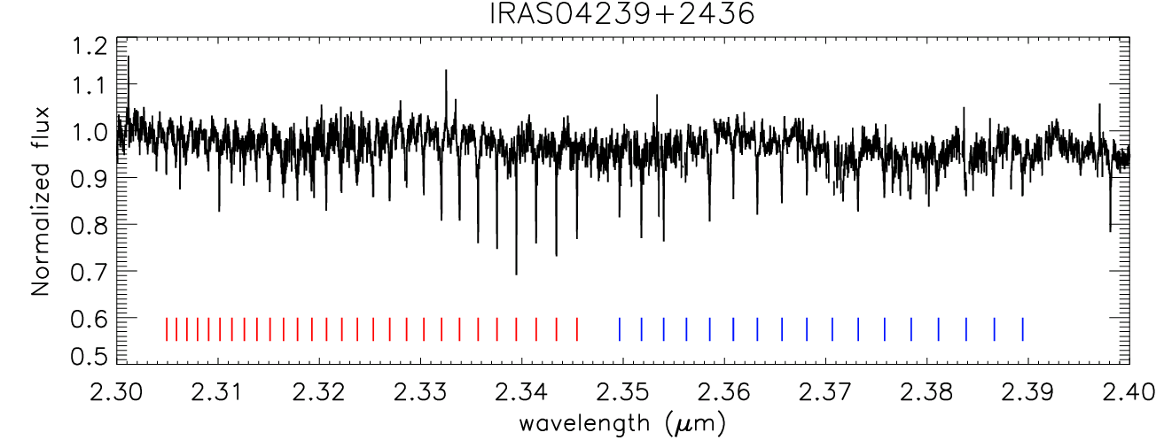
Results & Discussions: CO (v= 0→2) Absorption Lines
R(J) : J → J +1, v=0→2
P(J) : J → J -1, v=0→2

Slide 13
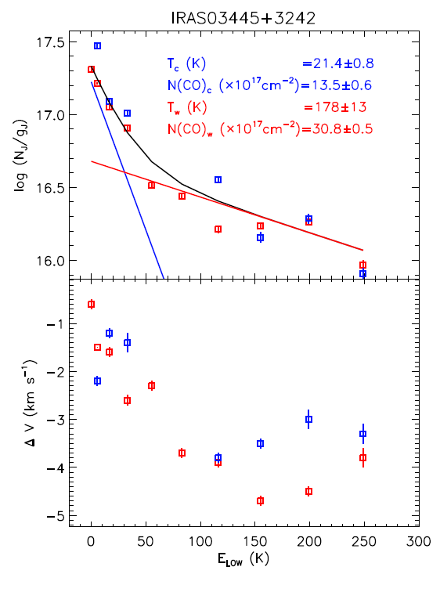
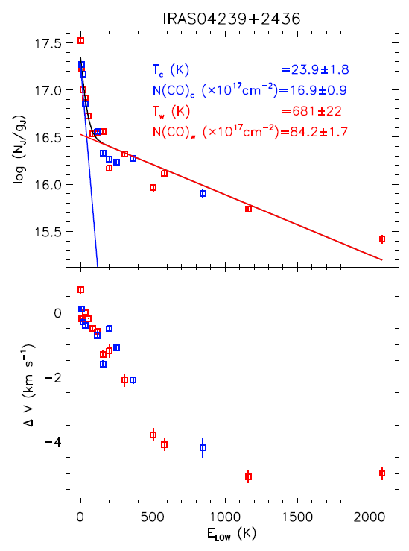
Results & Discussions: Narrow CO absorption lines
Assumption : LTE + optically thin
Blueshifted warm gas ➔ wind or outflow

Slide 14
Cartoon of disk derived from the CO overtone transitions
V_{wind/outfow} ~5 km s⁻¹
V_{rot} ~100 km s⁻¹
≤ ~ 0.15 AU
Scale is not linear!!

