Slide 1
IGRINS High-Resolution Spectroscopy FU Ori Type Object 2MASS J06593158-0405277 (V960 Mon)
Tae-Soo Pyo
Subaru Telescope/NAOJ
2015.11.11

Slide 2
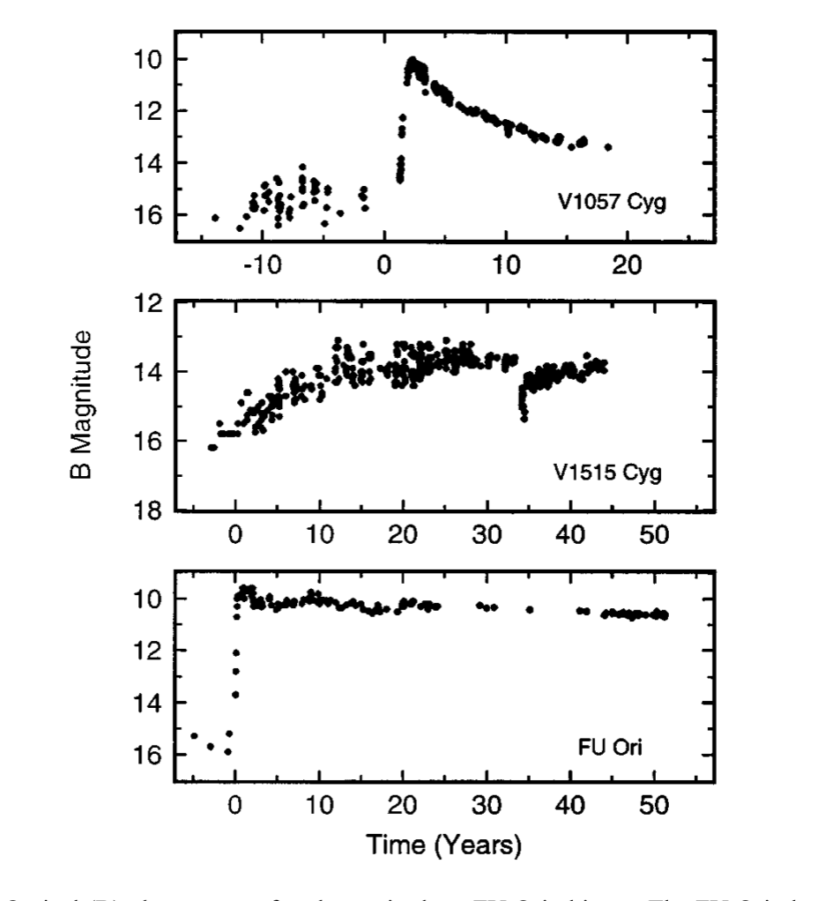
FU Ori type: Long-term Light curve
FU Ori type: ~ 3-4 magnitude
brightening
~ 20 objects
Distinguish the type of FU Ori
outburst with long-term observation
Hartmann & Cannon 1996

Slide 3
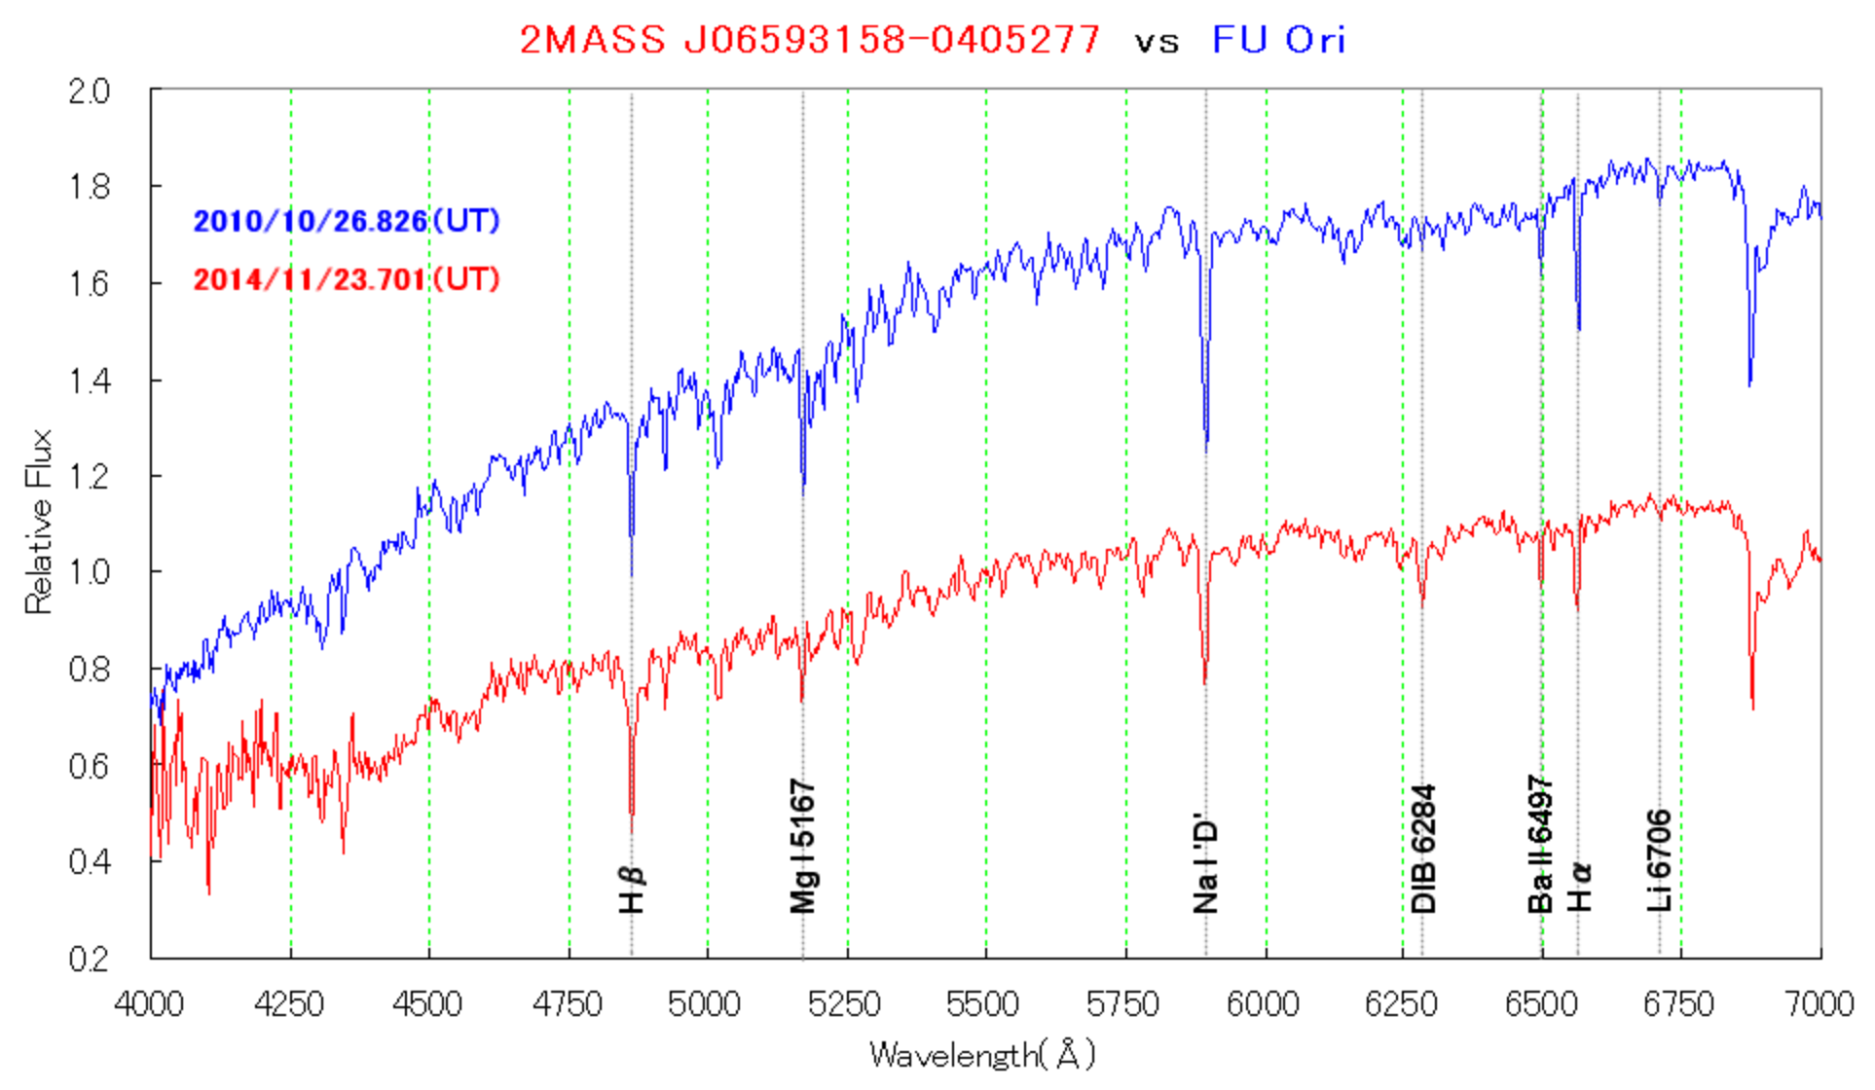
2MASS J06593158-0405277
2014. Nov.30 (ATEL#6770):
Maehara et al. report an outburst:
magnitude (>13 to 11.5): 2014.3 to 2014.9
R~ 600: low-res. spectrum

Slide 4
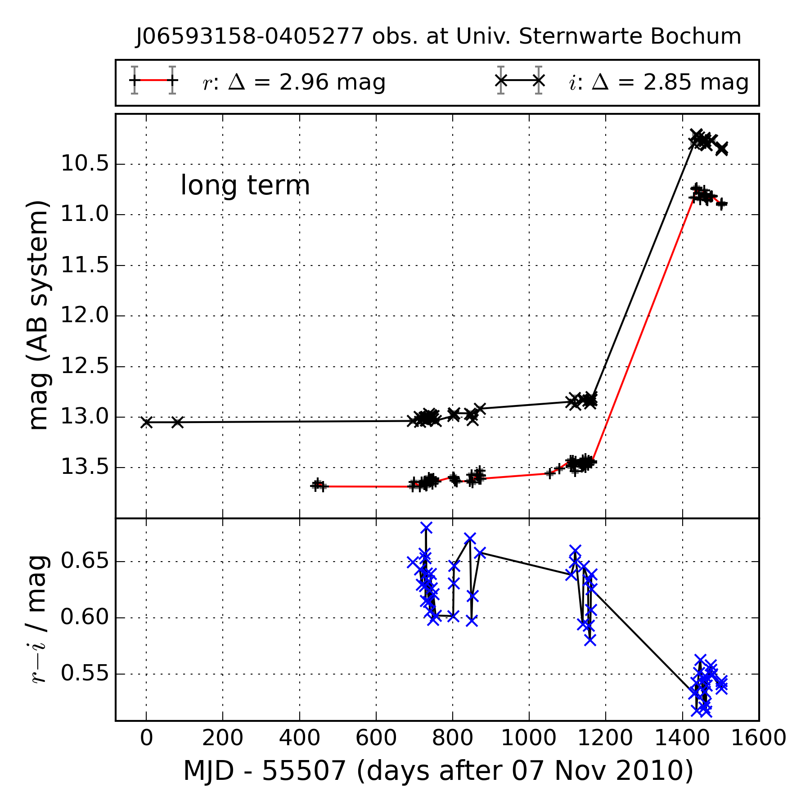
2014. Dec. 9 : Hillenbrand (#6797)
Observation: Keck/HIRES w/ R ~ 72,000
Optical spectrum : early F giant or super giant
P-cygni profiles of Hα → strong wind resemble with FU Ori.
2014. Dec. 19: Heckstein et al. (ATEL#6838)
- 15cm telescope
2009.Nov – 2014.Dec
- Δm=2.6 :
Outburst at 2014.Jan - Oct

Slide 5
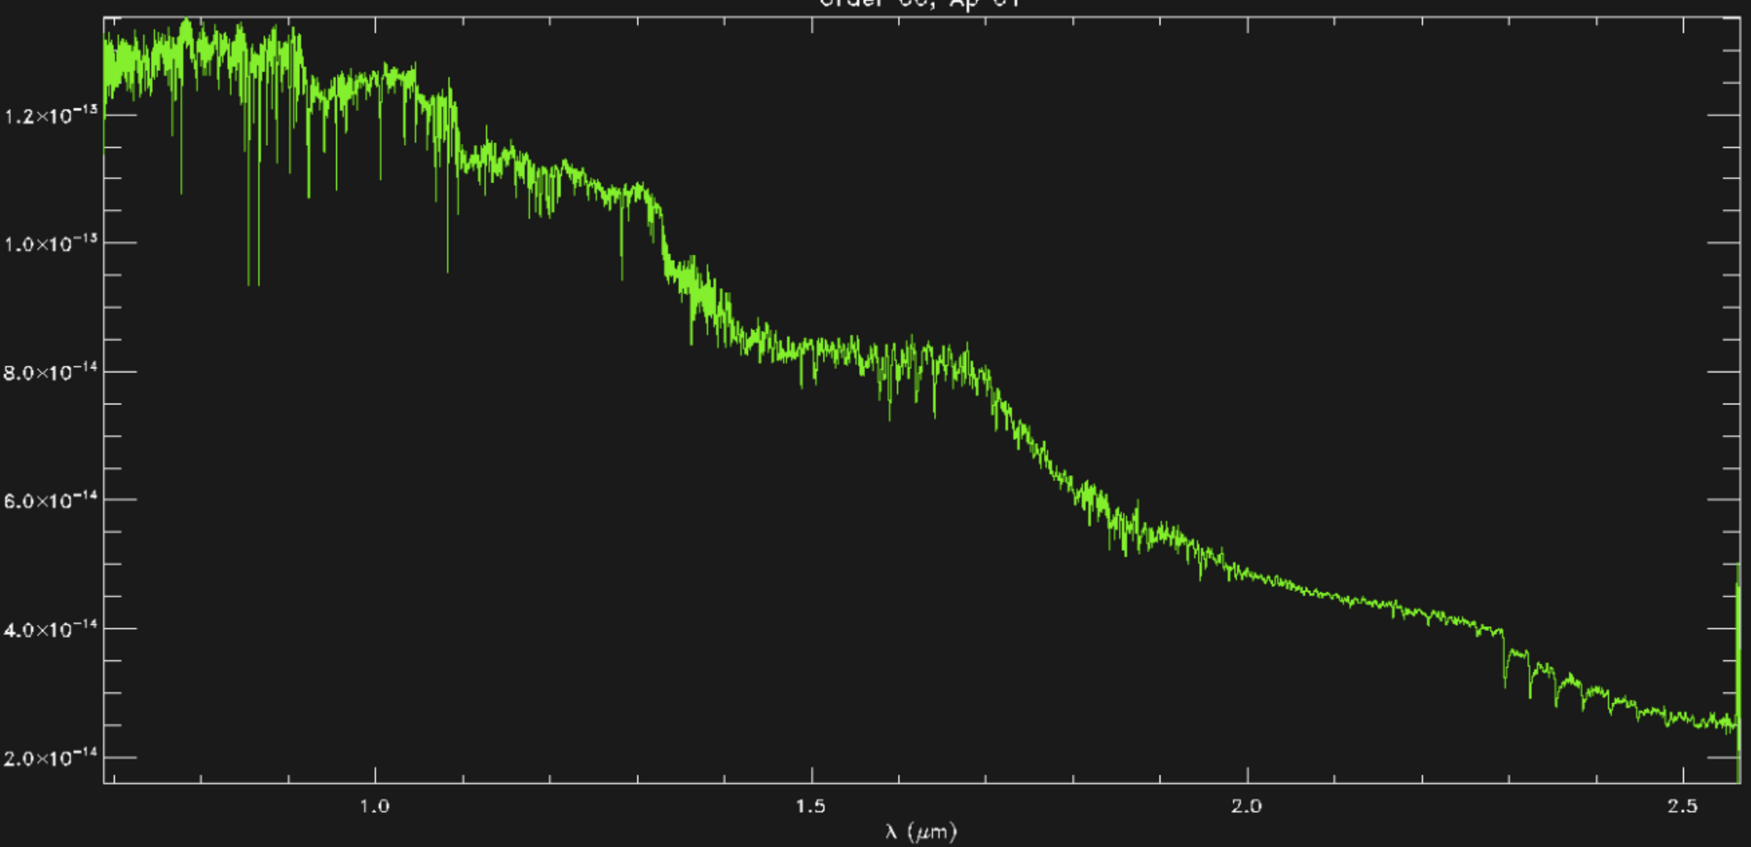
2015. Jan 1 : Reipurth et al (ATEL#6862)
NIR low-res. spectra w/ IRTF/SPEX (R~ 1300)
late-K and late-M type star w/ CO absorb. Band.
IRTF/SPEX @ 2014.Dec. 21

Slide 6
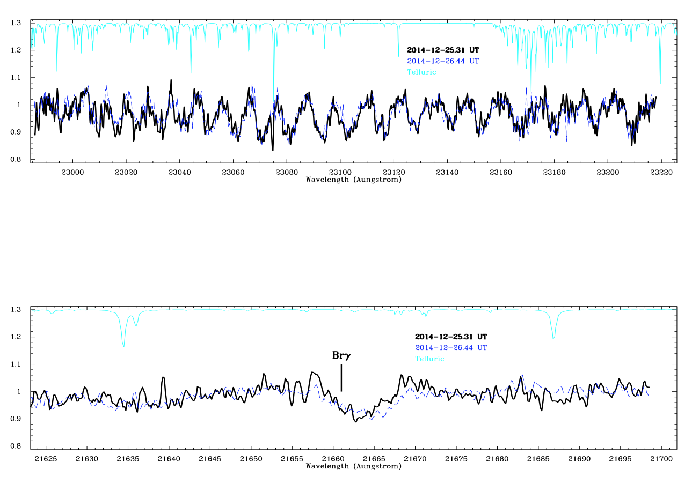
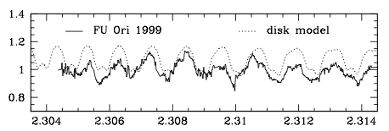
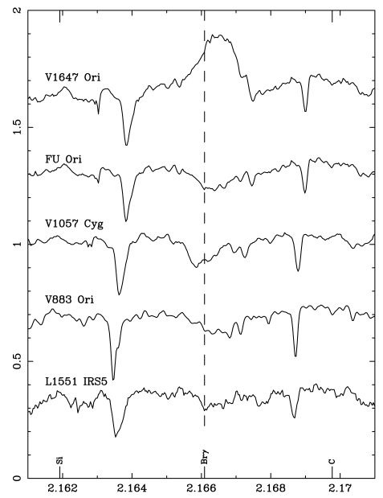
IGRINS K-band High-Resolution Spectroscopy of the FU Ori Type Object 2MASS J06593158-0405277 Tae-Soo Pyo (NAOJ), Heeyoung Oh(UST,KASI), In-Soo Yuk (KASI), Hwihyun Kim (KASI,UT), C. J. Davis (Liverpool John Moors Univ., UK)
ATel # 6901
We confirmed that newly found outburst object 2MASS J06593158-0405277 showed similar spectrum with FU Ori star:
[1] 2.3 – 2.32 μm:
CO first overtone band mixed with H₂O lines
Hartmann et al. 2004
[2] Br γ : Absorption not emission
OBS: 2014. Dec. 25 & 26 UT
Report [ATel# 6901]: 2015.Jan.11
Aspin et al.(2009)

Slide 7
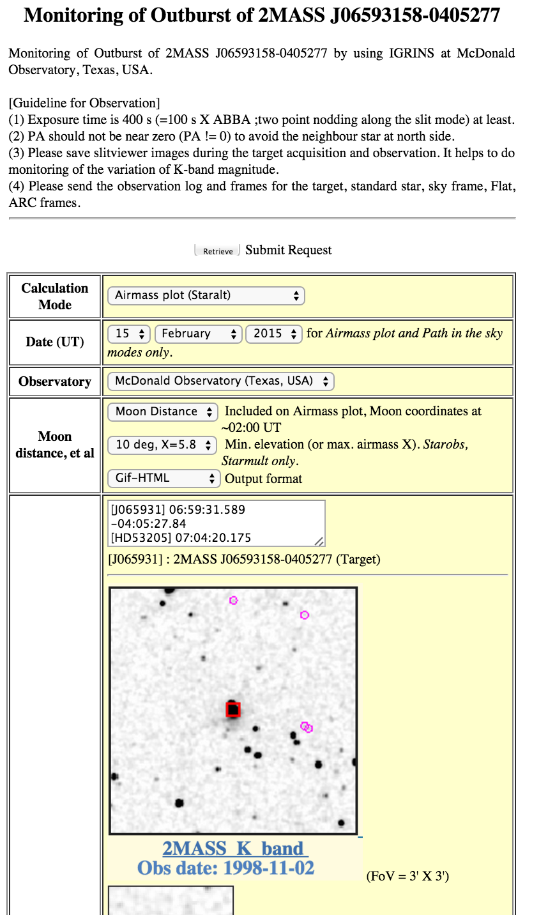
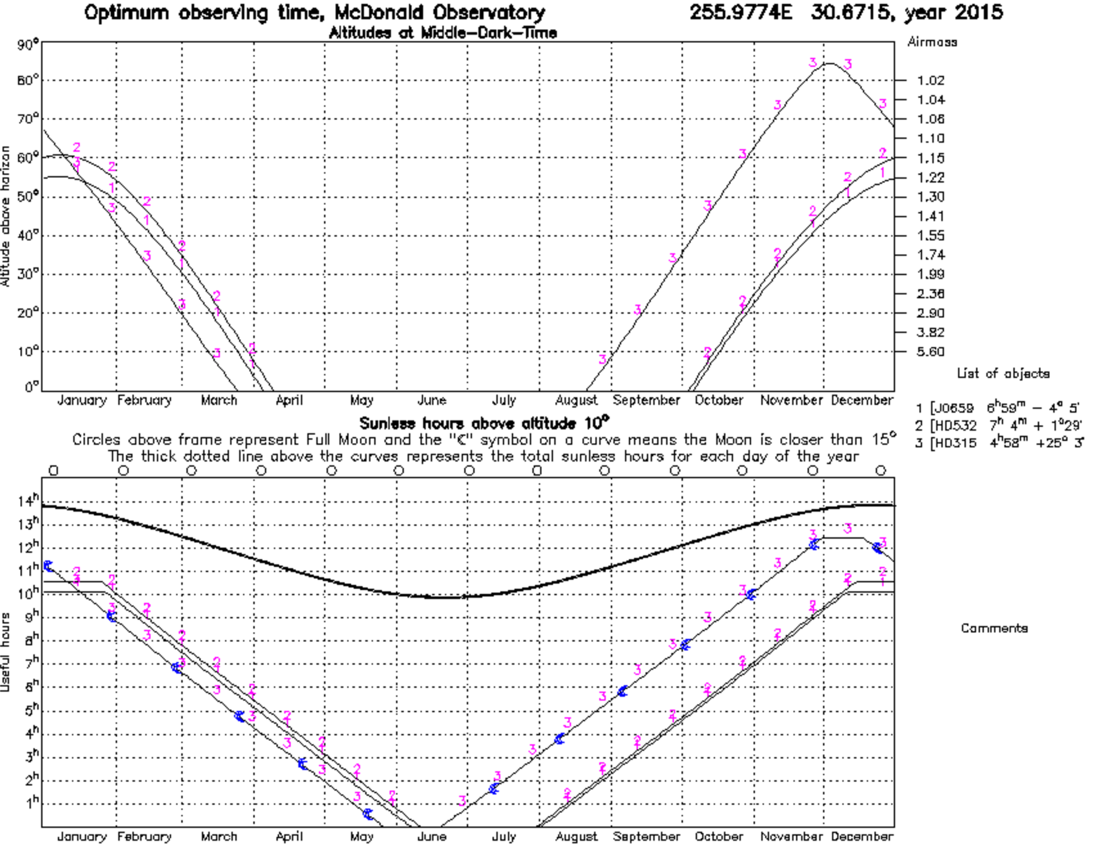
Monitoring Observation
2014. Dec. 24-25
2015. Jan. 20,23,27
2015. 5/1 (by JungEun Lee team)
http://www.naoj.org/staff/pyo/IGRINS/monitoring.html

Slide 8
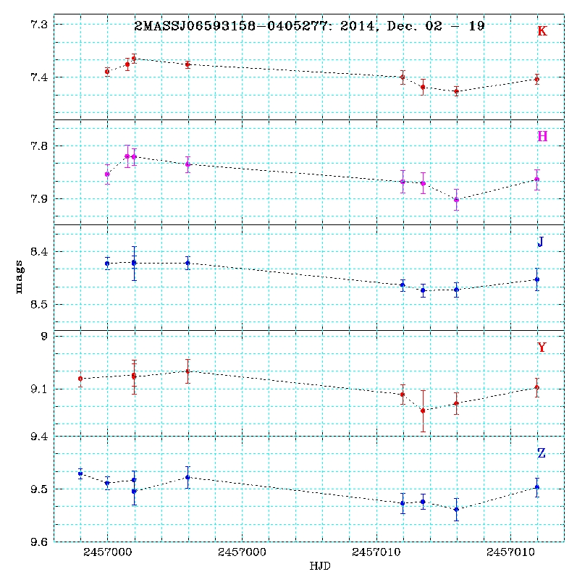
2015.5.29, Varricatt et al.(Atel #7578): Near-IR photometric monitoring of FU Ori Type Object 2MASS J06593158-0405277
A slight dimming and re-brightening 0.04 mag
(2014.Dec.2 – 19)
2015. Sep. 8, Semkov (ATEL#8019):
The new FUor candidate V960 Mon (2MASS J06593158-040
5277) still retains at high brightness level
- I = 10.11, R= 11.03 @ 2015.Sep.2-5

Slide 9
Conclusion
2MASS J06593158-0405277 is showing resemble spectra with FU Ori.
Tracing time variation with high spectral resolution will give important clue to identify type of star and a history of accretion and outburst.
Efficient pipeline and analysis tools are essential

