Slide 1
Chemical Compositions of Stars from IGRINS Spectra; the Good, the Risky, and the Ugly some comments on the uses and abuses of ordinary stellar abundance analyses Chris Sneden – UT Austin

Slide 2
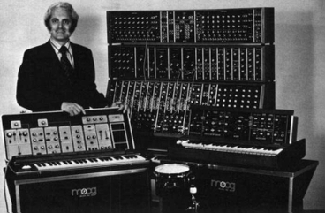
Many people have used MOOG – a “standard” software package for line analysis & spectrum synthesis
Robert Moog (1934-2005), pioneer of electronic music, inventor of the Moog synthesizer
Google header, May 23, 2012: www.google.com/doodles/robert-moogs-78th-birthday

Slide 3
MOOG’s computations are based on well-known physical assumptions
almost a purely traditional analysis
LTE assumed in ionization/dissociation/excitation
source function = Planck function
plane-parallel geometry
integral solution to radiative transfer equation
these assumptions make the computations fast
a version of the code can do continuum scattering
important for low metallicity stars in the UV
Jennifer Sobeck, U Virginia has this code
differential solution to radiative transfer equation

Slide 4
Virtue: a single code with many output modes
As a stand-alone code:
single star equivalent width matching
single star blended line equivalent width matching
single star spectrum synthesis
spectroscopic binary synthesis
integrated light equivalent width matching
integrated light spectrum synthesis
curve of growth calculation
As a slave to wrapper codes:
single synthetic spectra
grids of synthetic spectra

Slide 5
very simple input structure
minimum requirements
stellar model atmosphere
atomic/molecular line list
a ``parameter” file to give MOOG instructions
additionally, for equivalent width matching
measured EW’s added to line list
additionally, for synthetic spectrum matching
the observed spectrum (FITS or ascii)

Slide 6
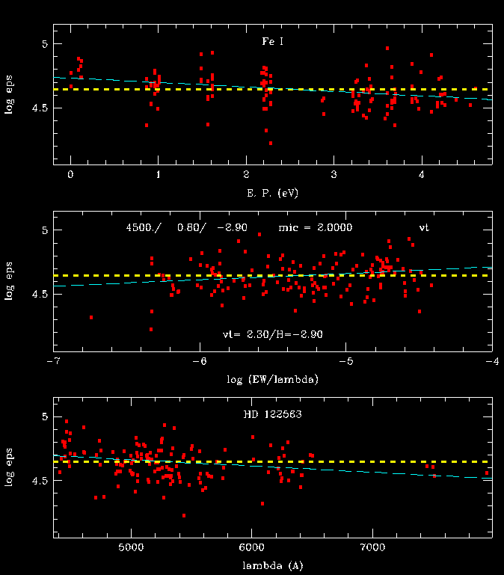
typical graphical EW output
user can alter assumed model or microturbulence while the code is running
the mean correlation lines are simple linear least squares; they can be reliable or very bad, depending on the line-line scatter
watch out: the plots auto-scale vertically (in abundance range)
log ε(X) = log₁₀(N_{X}/N_{H}) + 12.0
appropriate tabular output is also generated

Slide 7
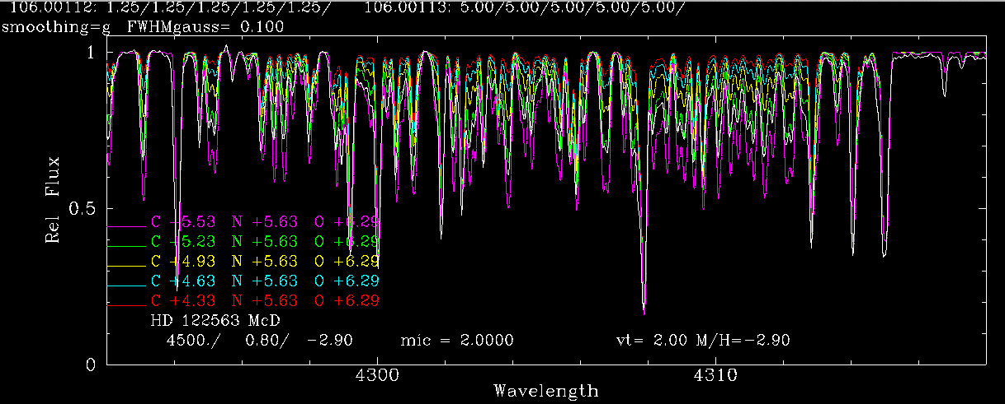
typical graphical output for syntheses
strictly log ε output!
many graphical actions can can be made
abundances and isotopic ratios can be adjusted in real time
a lot of text information so that the user can refer back to saved plots later
o-c deviation plot can be requested; appropriate text tabular output is automatically done

Slide 8
Risky behaviors (code-independent?)
unreliable input data
a big problem is poor transition data in linelists
I do not like “blind” use of line databases
e.g., Kurucz compendium, VALD compilation
inappropriate kind of star
any emission-line star; Wolf-Rayet, etc.
extreme supergiants
stars with spots, other significant perturbations
inappropriate spectral features
VERY large lines like NaD, Ca II H&K
spectral regions with no definite continuum (the UV)

Slide 9
Please think! MOOG can’t correct these abundance sins:
using lines with log RW = log (EW/λ) > 4
reporting LTE abundances for species with big NLTE effects
Al I, Mn I; resonance lines give VERY low abundances
O I, C I very high excitation lines
trying to model Balmer lines
working on He-rich atmospheres s
deriving abundances at the Balmer jump
Futures
porting graphics to Python, away from sm
finishing integrated-light routines
making the code inherently a parallel architecture

Slide 10
Acquiring MOOG: http://www.as.utexas.edu/~chris/moog.html Access to line lists http://www.as.utexas.edu/~chris/lab.html

Slide 11
Many thanks for allowing me to be part of this excellent meeting and workshop!

